Slide 1
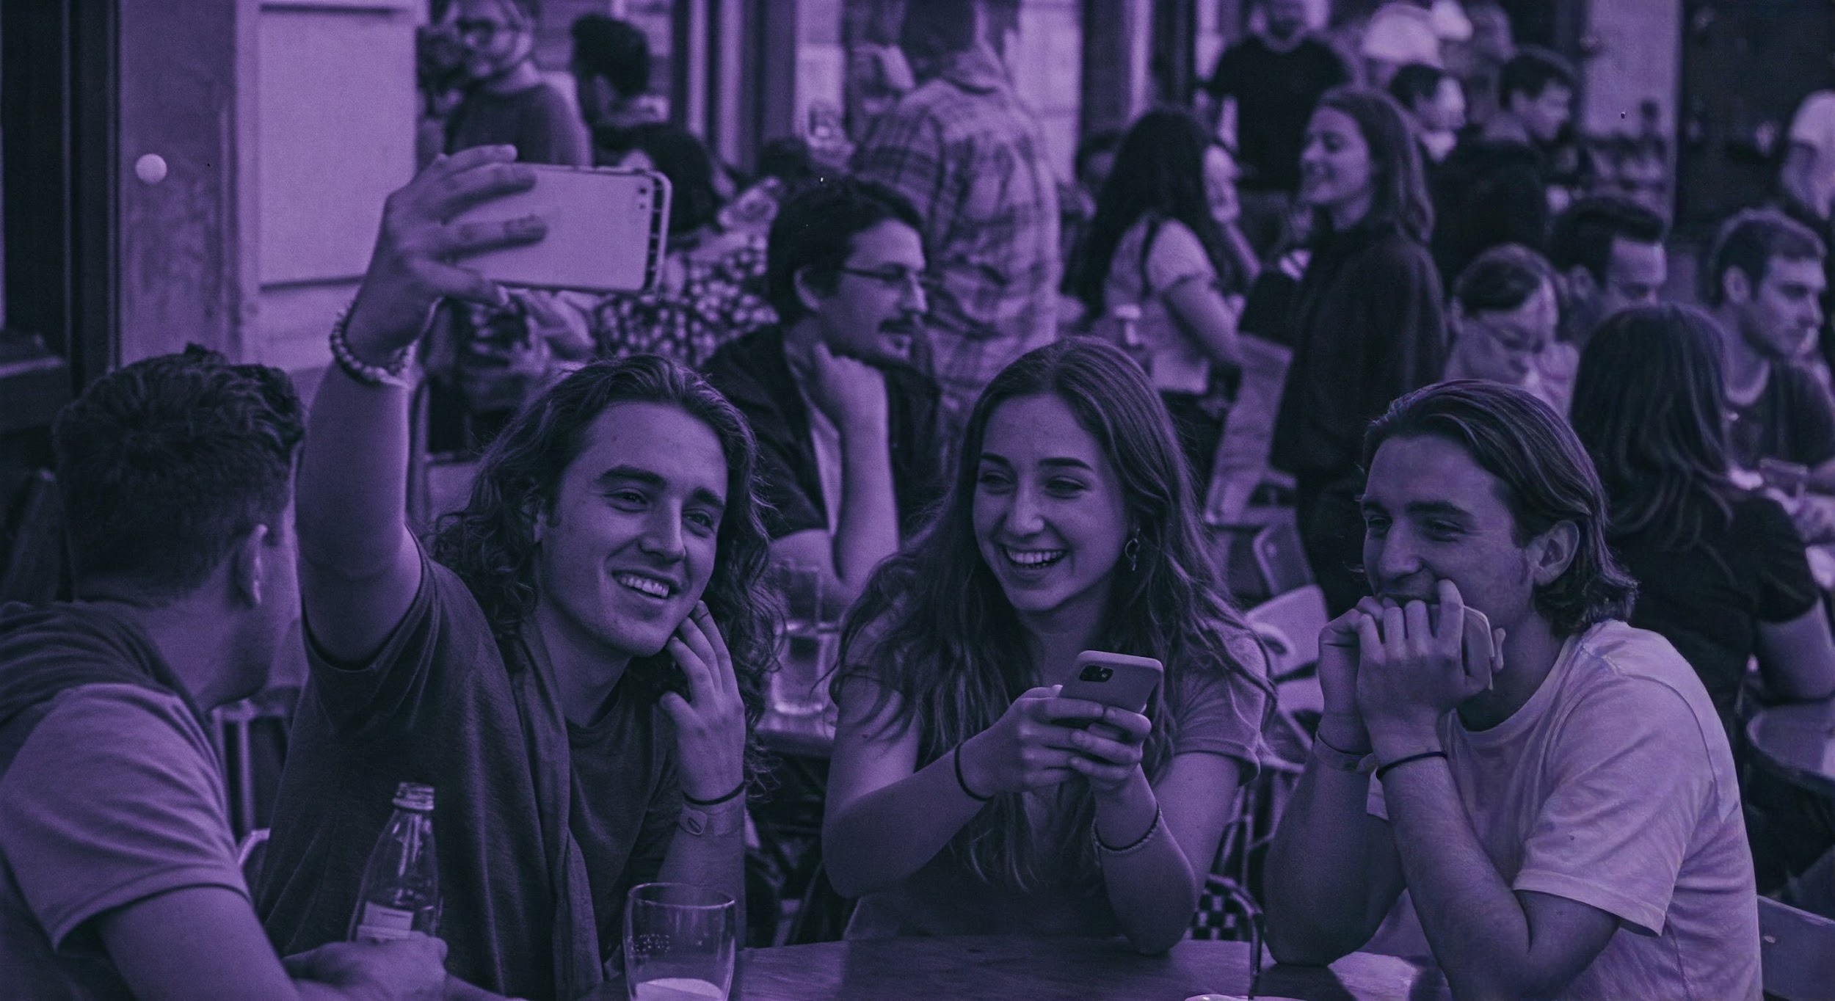

Brand Guidelines

Slide 2
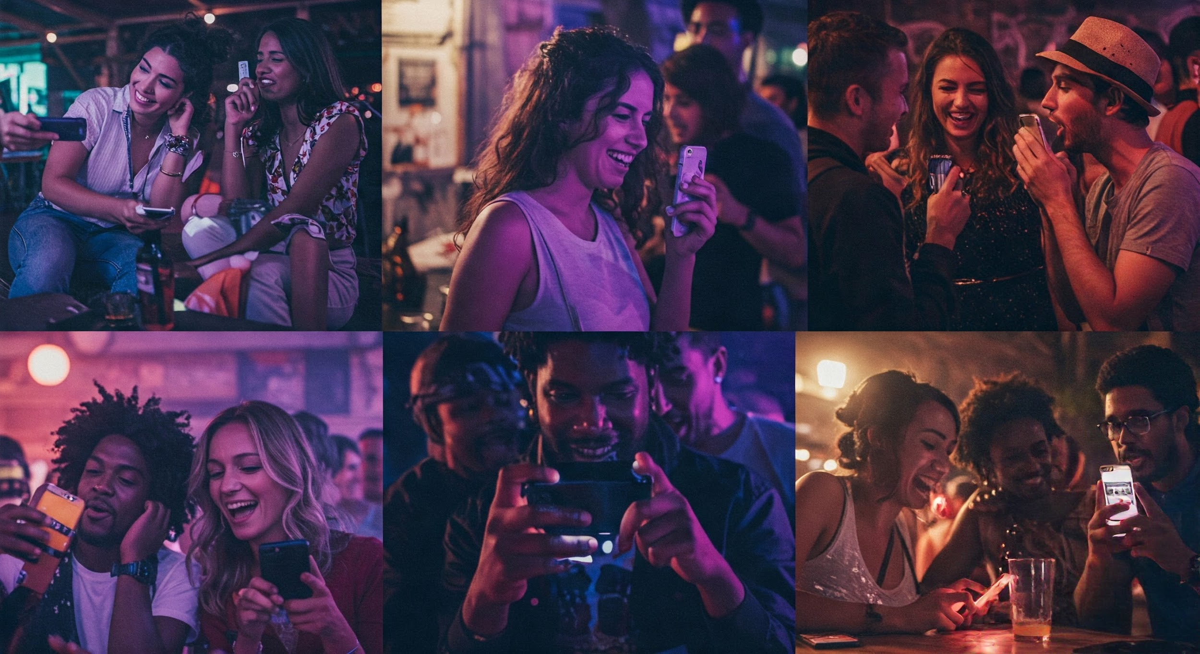

Pulse Mobile is a vibrant, disruptive mobile service provider that understands how Gen Z and Millennials live in a constantly connected world. We offer transparent pricing and flexible plans that resonate with the 18-30 demographic.

Slide 3
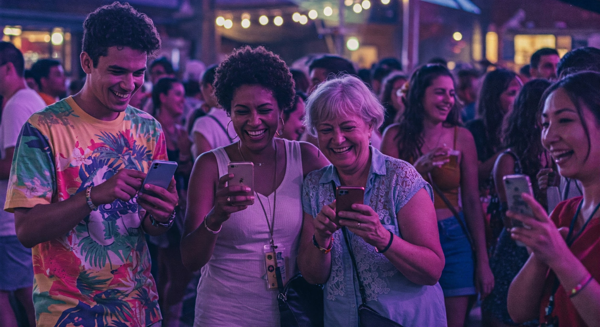
Pulse Mobile was born from the frustration of traditional carriers' complicated plans and hidden fees.
We believe mobile service should be as straightforward as texting your best friend.
Our approach combines digital-first interactions with genuine human connection, creating a community rather than just customers.

Slide 4
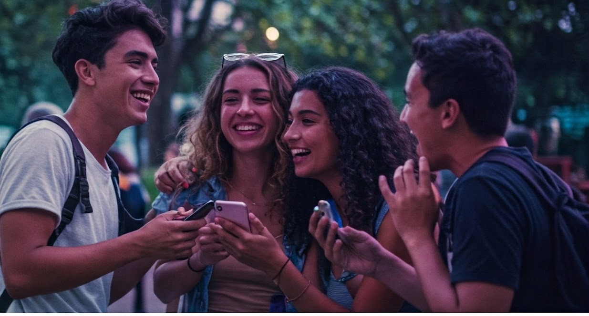
Connection that keeps up with you

Slide 5
Brand Voice & Personality
Personality
Tone
Bold: We’re not afraid to challenge industry norms
Authentic: We speak human, not corporate
Witty: We use humor that resonates with our audience Inclusive: We celebrate diversity and create belonging
Conversational, not formal
Direct and transparent
Playful but not immature
Culturally hip without trying too hard

Slide 6
Logo

Slide 7
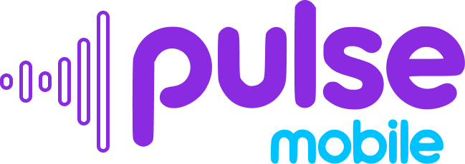


Pulse Mobile
Logo
Full Logomark
Icon
Logomark

Slide 8





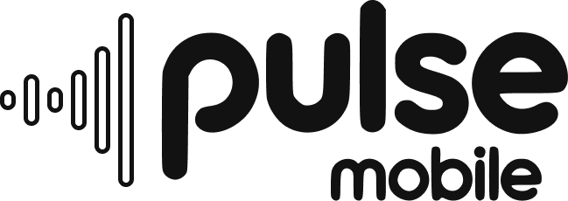
Logo Variants
color
black
white
color
black
white
color
black
white

Slide 9
Typography

Slide 10
Typography
Primary Font
Secondary font
Headlines Montserrat Alternates Semi Bold
Body Montserrat Regular
Digital interfaces Data visualization Space Mono

Slide 11
Colors

Slide 12
Pulse purple Primary brand color
Electric blue Secondary color, digital
Mint green Accent color, call to action
Sunrise yellow Highlights, high-energy
Coral red Alert states, limited offers
Midnight Dark backgrounds & text
Cloud Light background & text
Pulse purple #8a2be2 138, 43, 226
Electric blue #00c2ff 0, 194, 255
Mint green #4cd964 76, 217, 100
Sunrise yellow #ffd600 255, 214, 0
Coral red #ff5a5f 255, 90, 95
Midnight #121212 18, 18, 18
Cloud #f8f8f8 248, 248, 248
Notes:
https://coolors.co/8a2be2-00c2ff-4cd964-ffd600-ff5a5f-121212-f8f8f8

